Slide 1
A Brief Introduction to Structured Design
Errol Pelchat
CSCI 360
2-14-2004

Slide 2
Structured Design is
General Description
A programming Paradigm
The opposite of Unstructured Design
A method to help plan your program before you code it.
A top-down approach to design
A way to design your program to make it easier to code, change, maintain and understand.

Slide 3
Structured Design is
Specific Description
A methodology for breaking down a problem (goal/task/system) into smaller problems and solving the smaller problems (divide). Sub-problems are then arranged into a hierarchy that forms a sequence of procedures (conquer).
“Structured design is the art of designing the components of a system and the interrelationship between those components in the best possible way. “
”Successful design is based on a principle known since the days of Julius Caesar: Divide and conquer.”
- Edward Yourdon

Slide 4
Why structured design?
Good design makes for good programs
It makes code easier to understand
Helps to make programs modular
It is easier to trouble shoot
It makes programming more systematic and less ambiguous

Slide 5
Basic Steps
Identify Major Components of task/problem/goal/system
Decompose it into these components (the components represent procedures)
Group related components
Repeat the process as needed on individual components.
Organize components in a way that makes sense (such as a hierarchy, with and a consideration for data flow)

Slide 6
The Big Idea
Concern about the quality of programming code, and ways of making it easier to demonstrate the correctness of a program was needed. Structured Design/Structured Programming was purposed in the 1960s to promote a more organized approach to programming, and reduce bad coding habits that can cost excessive time and effort ($$$).
The Structured approach purposed a methodology that would allow us to better demonstrate correctness and improve quality of program code for long term use.

Slide 7
Structured Programming
Structured Programming is the implementation of a Structured design.

Slide 8
1960s Structured Programming
1970s Structured Design
1980s Structured Analysis
Structured
Analysis
Structured
Design
Structured
Programming

Slide 9
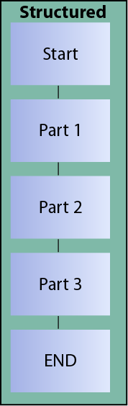
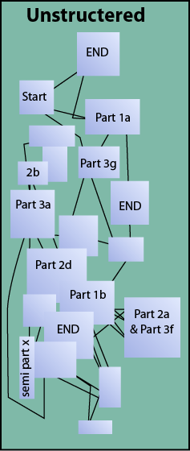
Structured versus Unstructured

Slide 10
Structured Design Heuristics
Design should be as modular as possible where it makes sense.
Parts that are related to one another should be grouped together, and unrelated parts should be distanced.
Black boxes should be used when possible “rule of black boxes”
“Whenever a function or capability is seen as being required during the design of a system, define it as a black box and make use of it in the system without concern for its structural or methodological realization. “
-Edward Yourdon

Slide 11
Implementation
The is no one philosophy for implementing a structured design.
  Use of the goto statement
  (Donald Knuth vs. Edsger Dijkstra)
  The invention of abstract data types
  Object Orientated Programming

Slide 12
The Goto Statement
Edsger Dijkstra suggested that it be banned from higher level programming languages
It can break the hierarchy or sequence of a program reducing modularity
Does not need an interface to execute

Slide 13
Structured Design & OOD
Similarly suggests breaking down problems into smaller pieces (procedures , objects)
OOD designs in terms of objects, Structured Design in terms of procedures.
Object Orientated Design has a greater focus on encapsulation, and information hiding. Structured design tends (but not always) focus on separating data from the procedures.

Slide 14
Sources
Books
Yourdon, Edward , Modern Structure Analysis, Yourdon Press, 1989
Klerer, Melvin, Design of Very High-Level Computer Languages, Magraw Hill Inc., 1991
Web
Yourdon, Edward and Constantine, Larry , Structured Design: Fundamentals of a Discipline of Computer Program and System Design, Selected quotes compiled by Tom Verhoeff
http://www.win.tue.nl/~wstomv/quotes/structured-design.html
Wikipedia, Structured Programming ,http://en.wikipedia.org/wiki/Structured_programming
Dijkstra, Edgar W., Go To Statement Consider Harmful, http://www.acm.org/classics/oct95/
Developer.com, Object Lessons: The Future of OO Design http://www.developer.com/design/article.php/1450841
Fichman, Robert G. and Kemerer, Chris F. , Object-Oriented and Conventional Analysis and Design Methodologies Comparison and Critique http://csdl.computer.org/dl/mags/co/1992/10/rx022.pdf

Slide 15
Questions ?

